Slide 1
Oakland County PROPOSED Service Modifications
2023

Slide 2
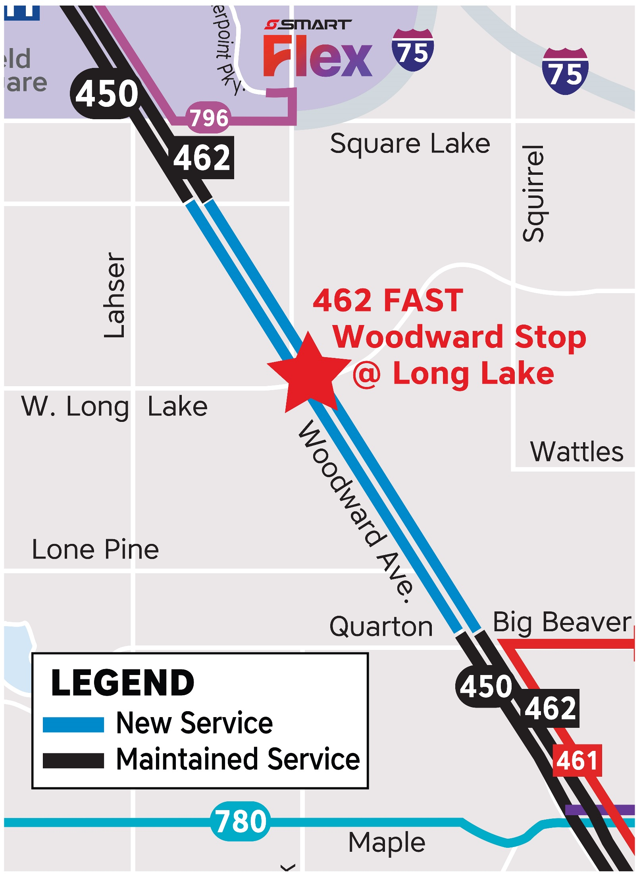
450 Woodward Local
462 FAST Woodward
– New service –
Through Bloomfield Hills
450 runs hourly on weekdays and Saturdays from 5:30 a.m. to 11 p.m., and every other hour on Sundays from 8 a.m. to 10 p.m.
462 runs hourly from 5:30 a.m. to 10:30 p.m. on Weekdays and Saturdays, and every other hour from 6:30 a.m. to 8:30 p.m. on Sundays
450 Woodward Local will serve stops every quarter mile through Bloomfield Hills; 462 FAST Woodward will serve the new limited stop at Long Lake.
Connects Bloomfield Hills with premium shopping and business destinations in Auburn Hills, Birmingham, Ferndale, Royal Oak, Midtown and Downtown Detroit 7 days a week

Slide 3
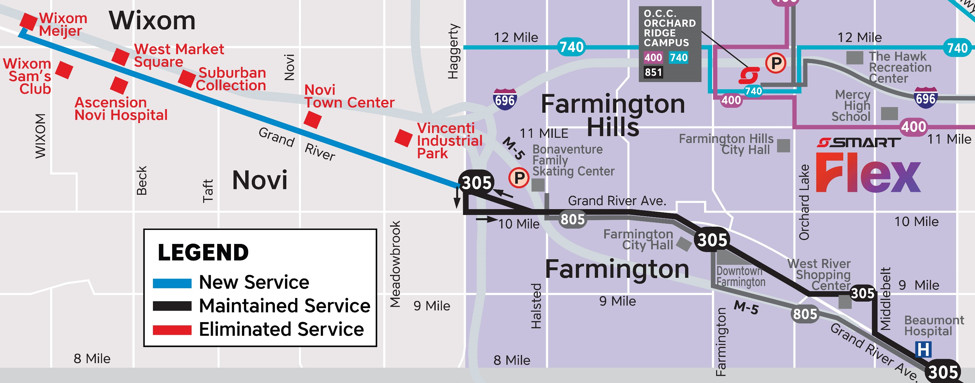
305 Grand River
Operates 6:30 a.m. to 11 p.m. weekdays & Saturdays, 6 a.m. to 8 p.m. Sundays
Reliable 60-minute frequency
Destinations include: Suburban Collection, Novi Town Center, Wixom Meijer, Sam’s Club, and Ascension Hospital
Easy transfer connections at Wixom Meijer, 7 Mile & Telegraph, and Old Redford Meijer
– EXTEND CURRENT ROUTE – From Farmington Hills to Novi and Wixom

Slide 4
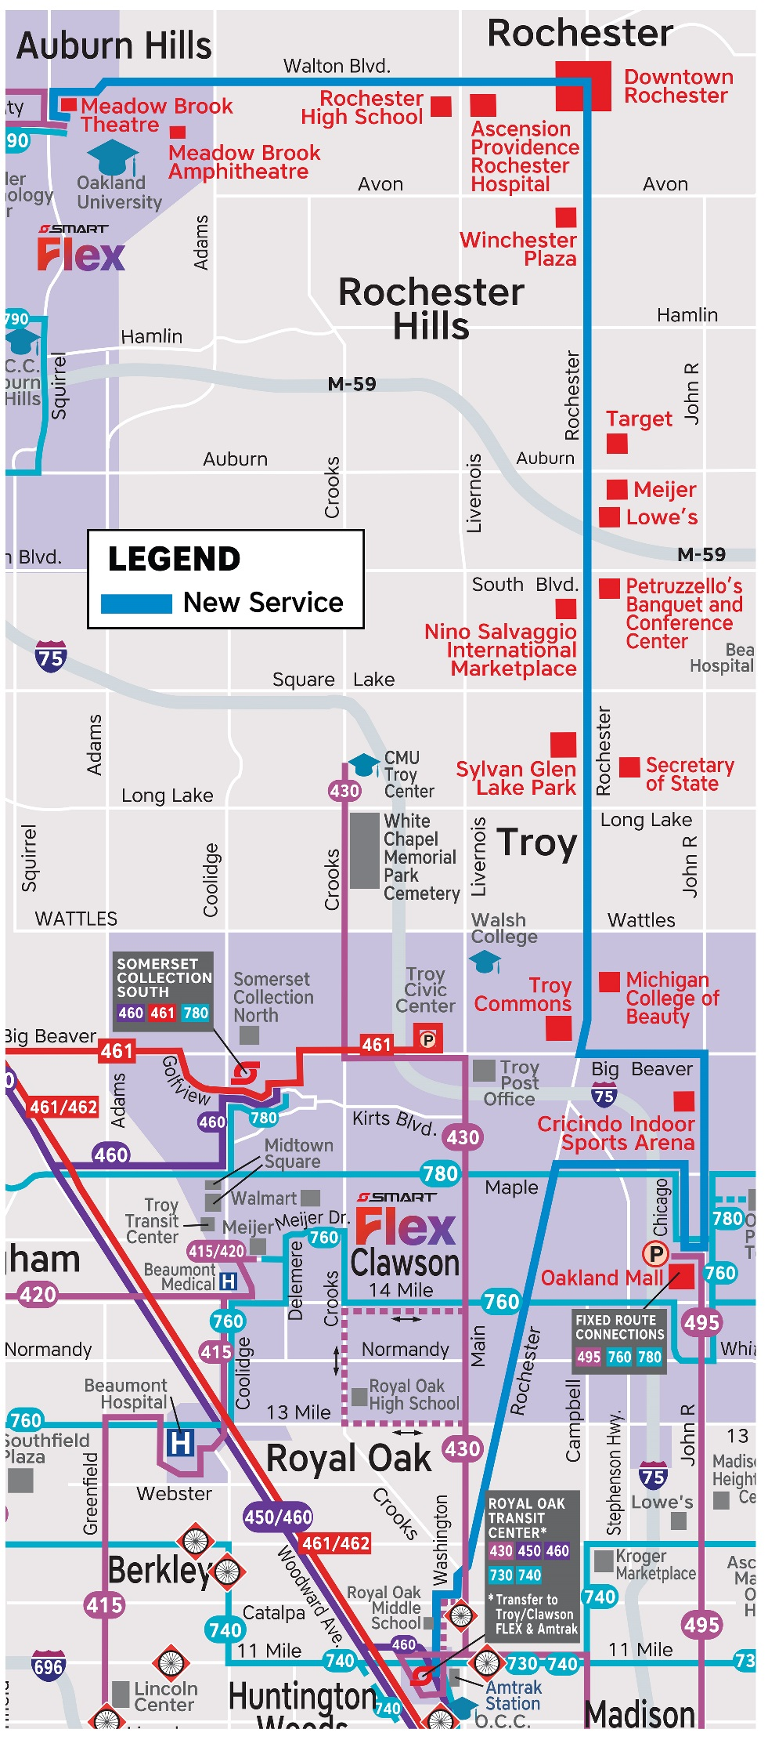
492 Rochester Road
– NEW ROUTE –
Rochester Road from Royal Oak through Rochester/Rochester Hills to Auburn Hills
6 a.m. to 10 p.m., on weekdays and Saturdays
Hourly service on all days served
From the Royal Oak Transit Center to Oakland University via Washington, Catalpa, Rochester, Maple, Chicago, Oakland Mall, John R, Big Beaver, Rochester, University/Walton, & Squirrel
New destinations: Sylvan Glen Park, Nino Salvaggio, Hampton Village Centre, Winchester Plaza, Downtown Rochester, Ascension Rochester Hospital, Meadowbrook Hall

Slide 5
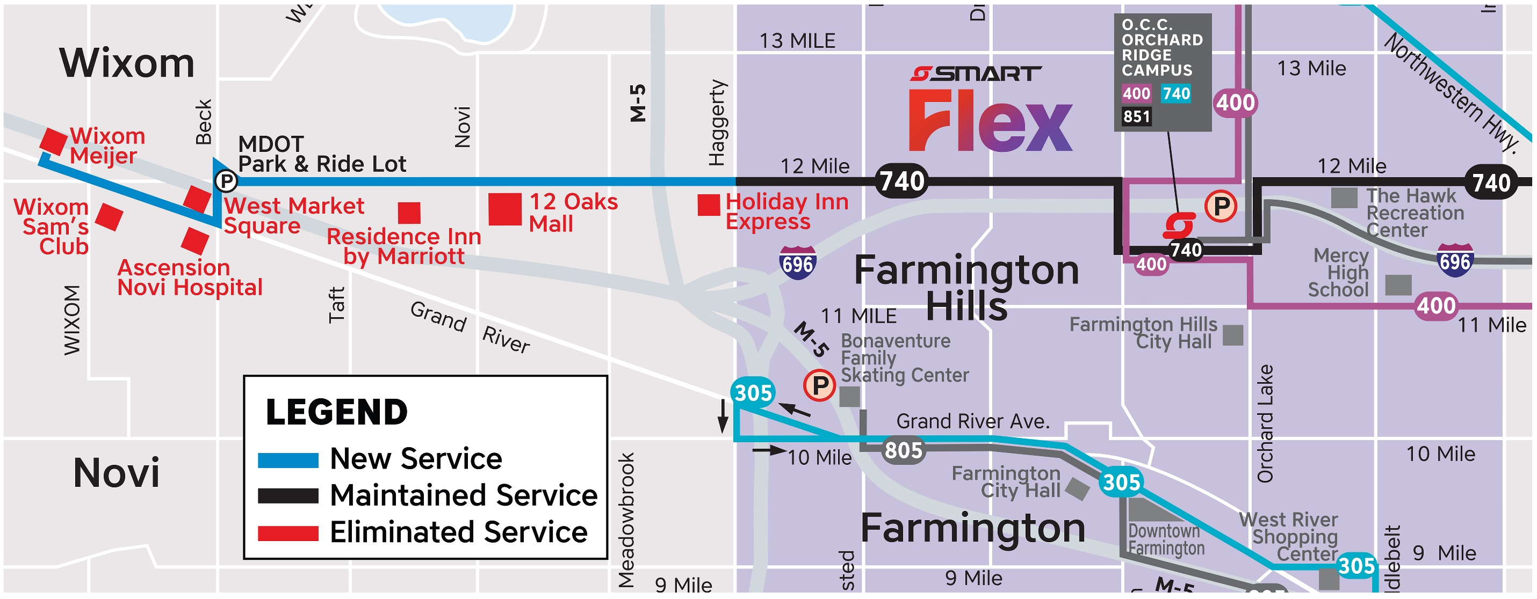
740 Twelve Mile
Hourly service from 5 a.m. to 10 p.m. weekdays & Saturdays; short trips from Royal Oak to Roseville on Sundays
New destinations: Twelve Oaks Mall, West Oaks Center, Ascension Hospital, West Market, and Wixom Meijer
Connects Wixom, Novi, Farmington Hills, Southfield, Lathrup Village, Berkley, Huntington Woods, Royal Oak, Madison Heights, Warren, St Clair Shores, and Roseville
– EXTEND CURRENT ROUTE – From Farmington Hills through Novi to Wixom

Slide 6
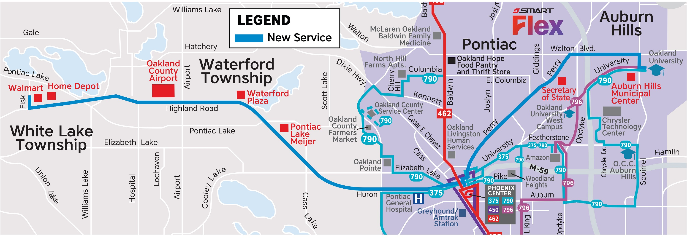
759 Highland Road
Operates every 60 minutes on weekdays and Saturdays, 7 a.m. to 9 p.m.
Provides service to: Oakland University, McLaren Hospital, Pontiac Lake Meijer, Oakland County Airport, White Lake Marketplace
Creates a strong crosstown corridor with flexible transfers to Detroit at the Phoenix Center, Bloomfield Twp. at Telegraph, and Rochester Hills at O.U.
– NEW ROUTE –
Auburn Hills through Pontiac, Waterford and White Lake Township along Perry and M-59

Slide 7
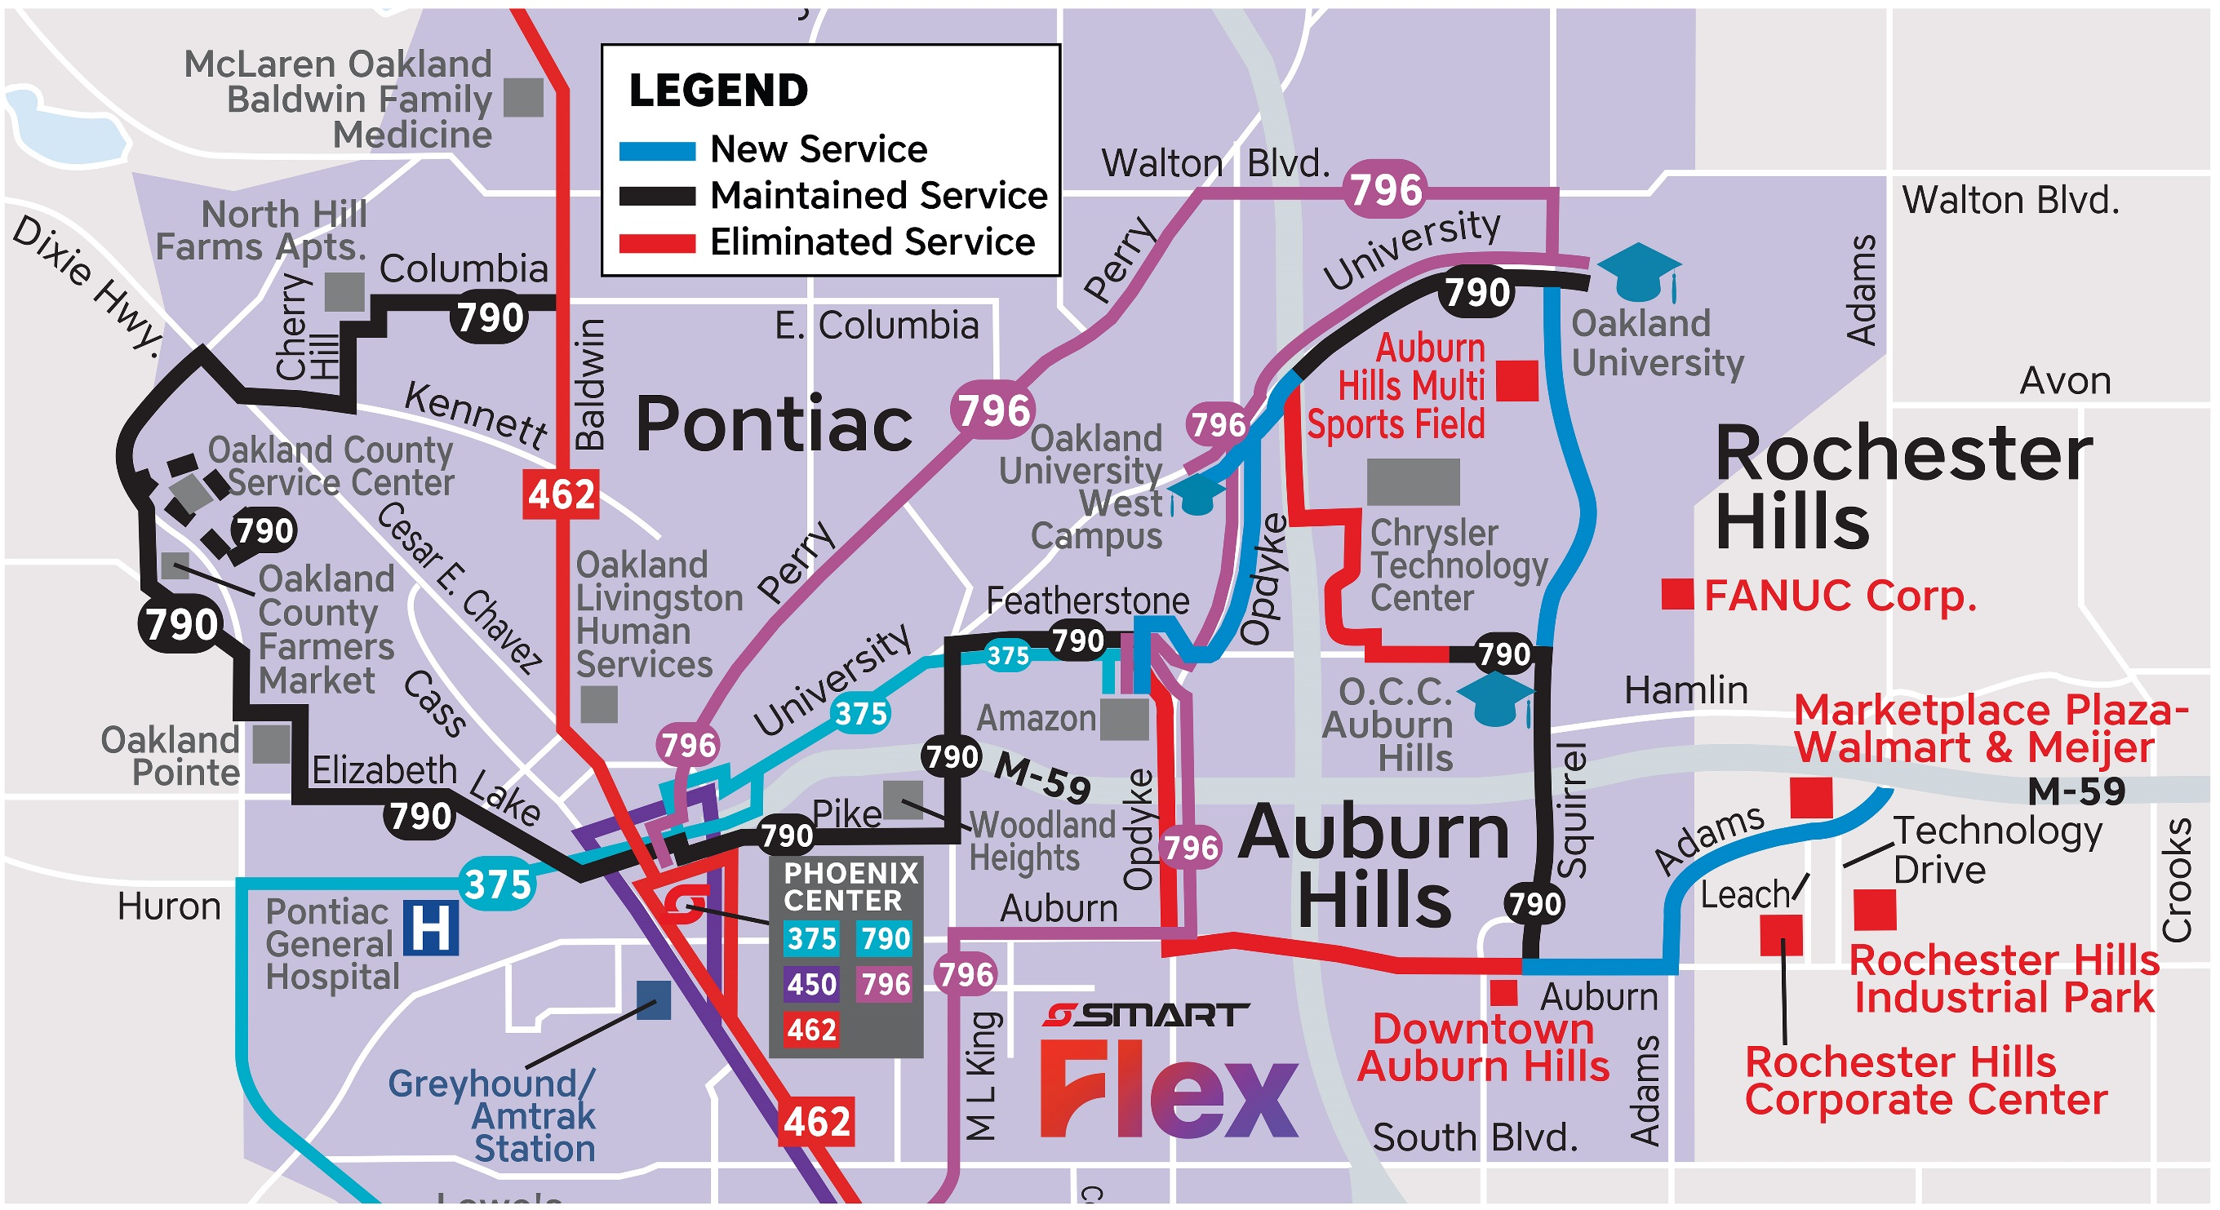
790 Pontiac Crosstown
– MODIFIED ROUTE –
To Better Serve Pontiac, Auburn Hills, and connect to Rochester Hills
Operates hourly 7 days a week; weekdays and Saturdays 5:30 a.m. to 9:30 p.m., Sundays 6:30 a.m. to 6:30 p.m.
Connects neighborhoods of east & west Pontiac, Auburn Hills, & Rochester Hills
From Amazon to Marketplace Plaza via Opdyke, OU-West, University, OU-Main, Squirrel, Featherstone, OCC, Squirrel, Auburn, & Adams
Revised service east of Amazon Pontiac provides better & efficient connections.

Slide 8
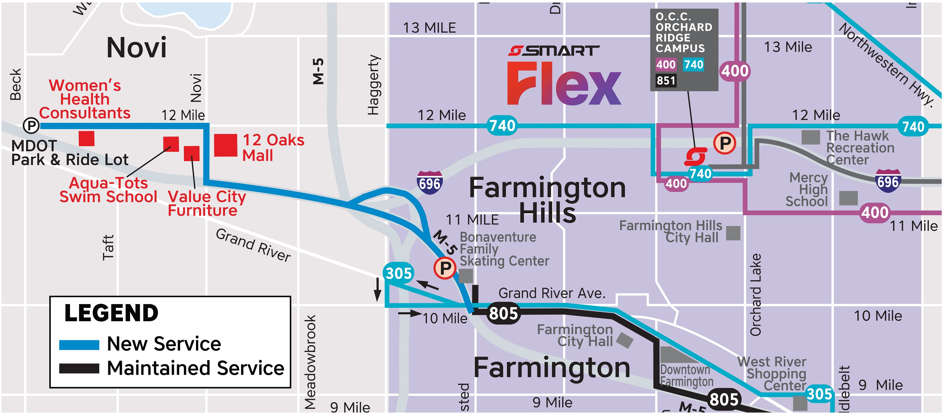
805 Grand River Park & Ride
Operates three morning and three afternoon trips into and out of Downtown Detroit
Runs during peak hours on weekdays
Express service that serves park & ride lots in Novi, Farmington Hills, and Redford, as well as local stops within the suburbs and Downtown Detroit
– EXTEND CURRENT ROUTE –
From Farmington Hills to Novi

Slide 9
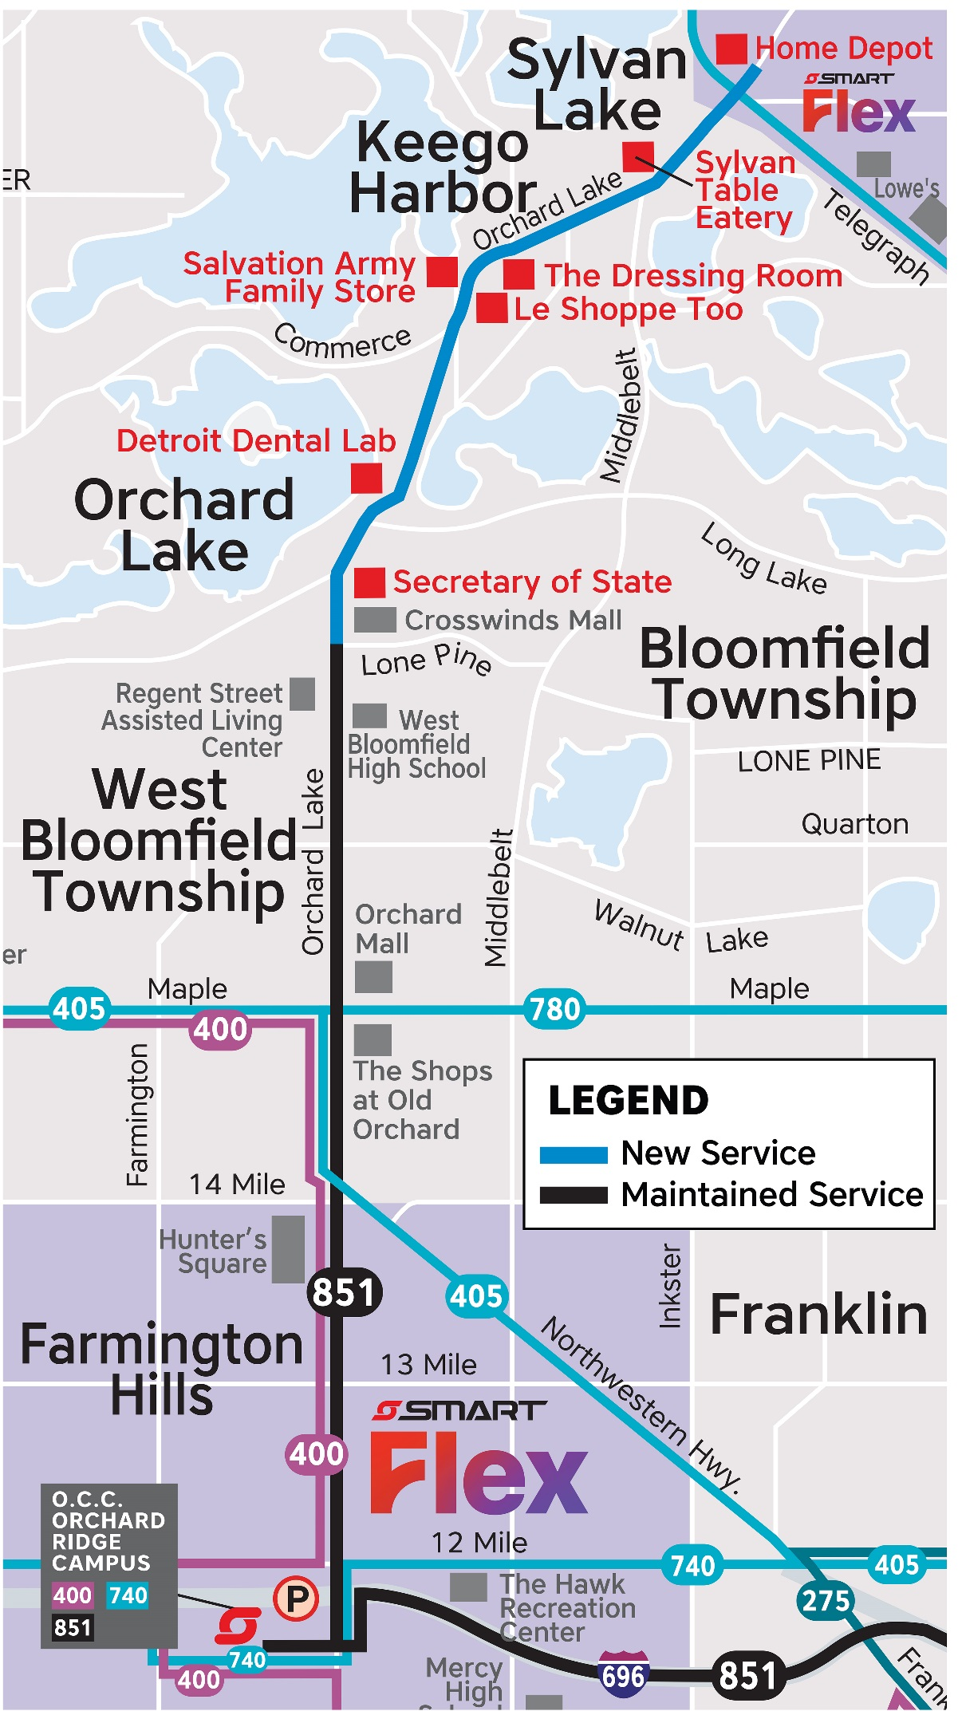
851 W. Bloomfield/Farmington Hills
Park & Ride
– EXTEND CURRENT ROUTE – From W. Bloomfield to Orchard Lake, Keego Harbor, and Sylvan Lake
Operates three morning and three afternoon trips into and out of Downtown Detroit
Runs during peak hours on weekdays
Connect from Orchard Lake, Keego Harbor, and Sylvan Lake via Orchard Lake Road to West Bloomfield, Farmington Hills, and downtown Detroit
Will connect to downtown Pontiac once the Woodward Loop reconstruction project is completed

Slide 10
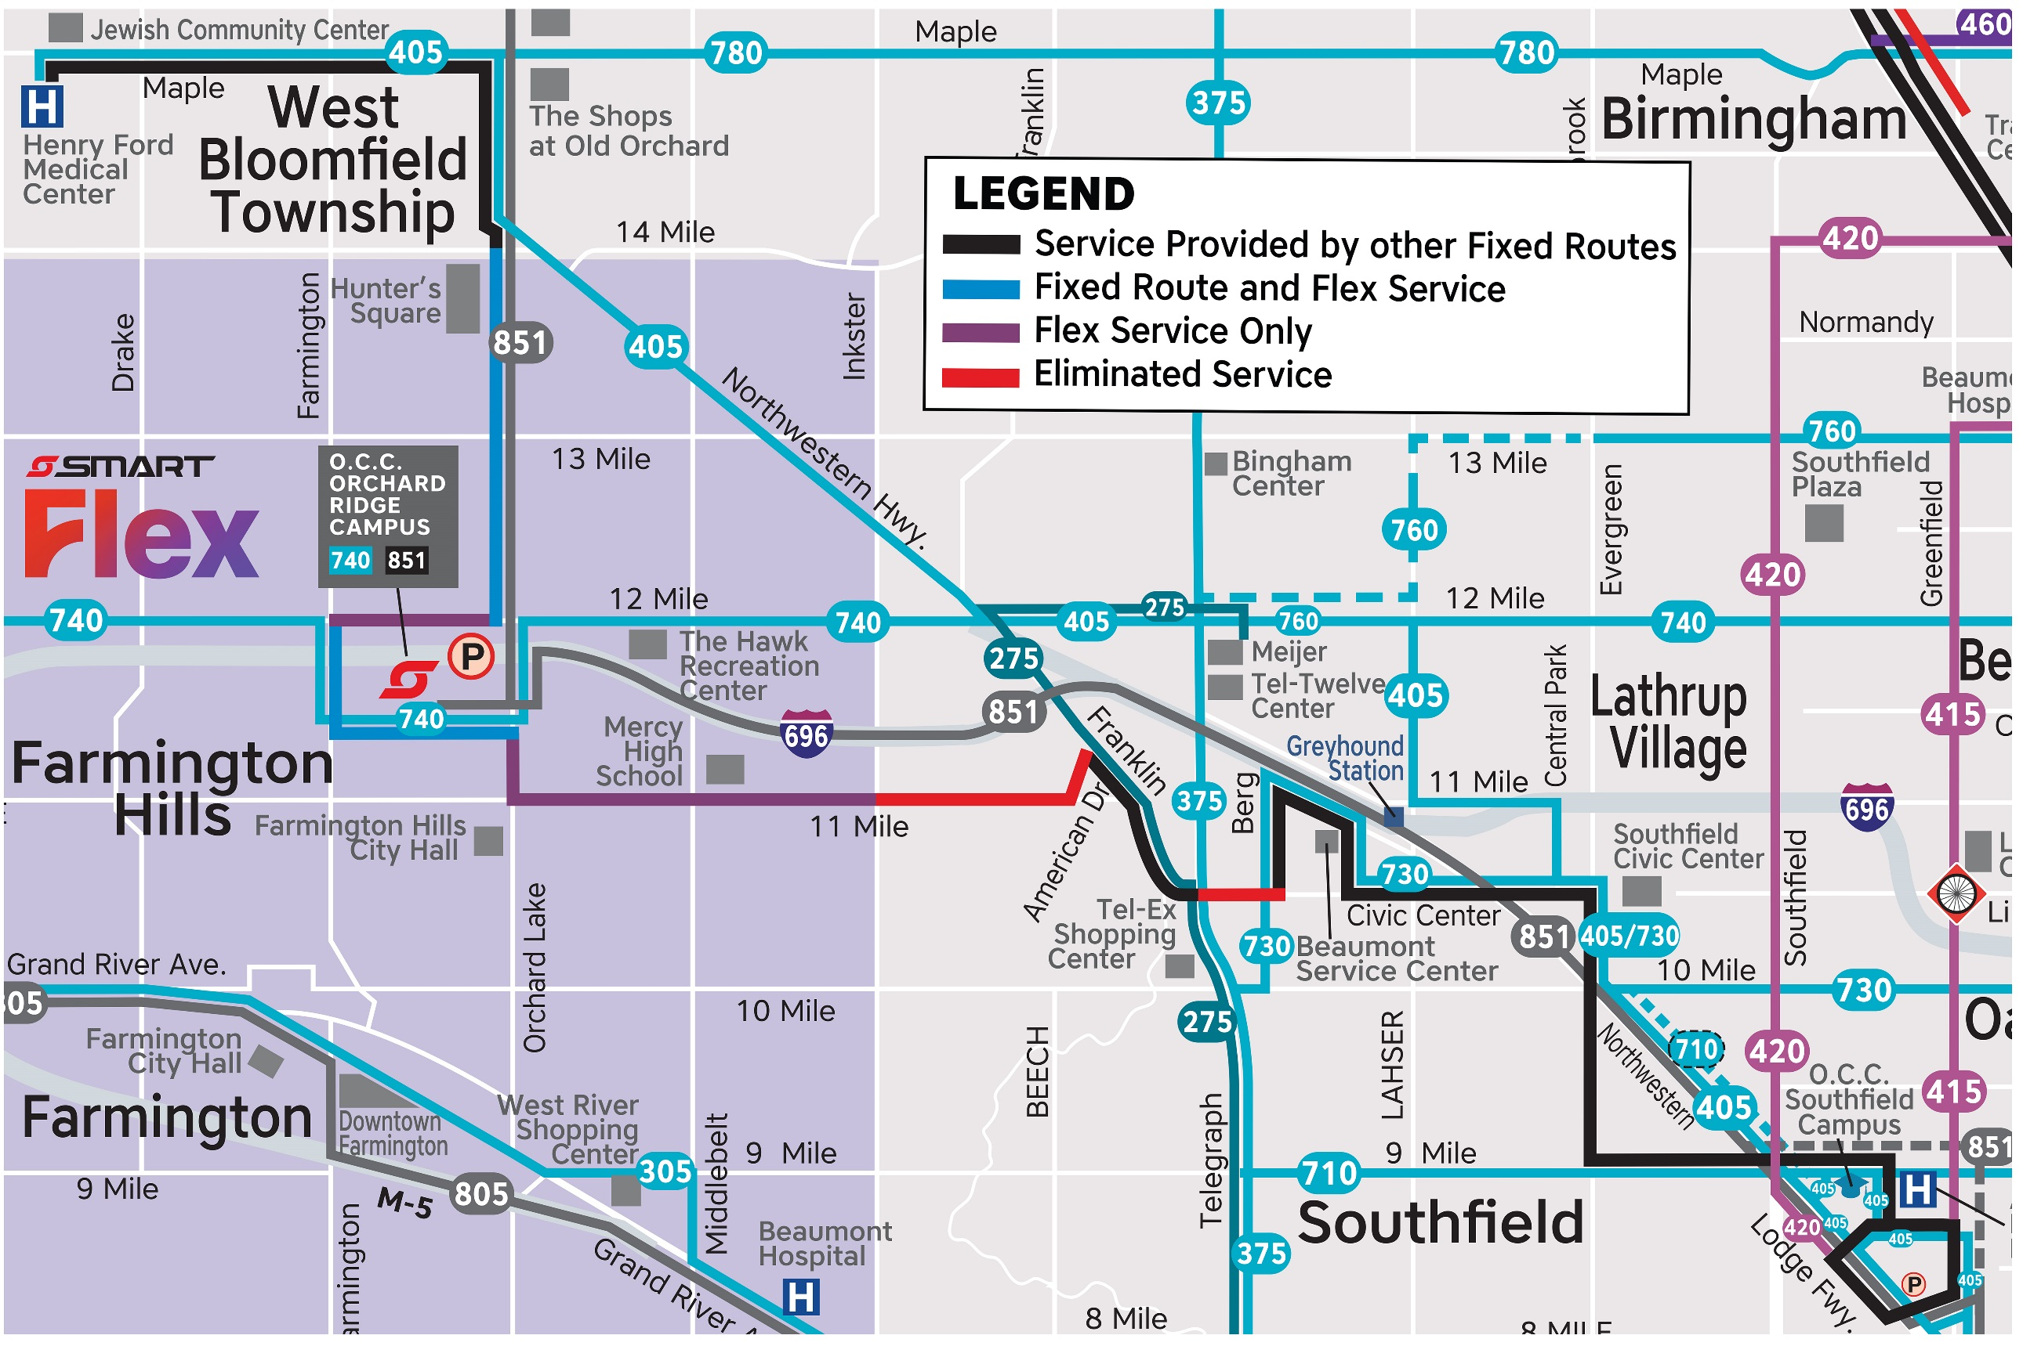
400 Southfield/Orchard Ridge
– DISCONTINUED ROUTE –
The route will be discontinued due to:
Low ridership but high operating cost
Duplication of other Fixed Route Services (over 90% of service is provided by other routes)
Access these routes as alternatives:
Northland – 405 Northwestern, 415 Greenfield, 420 Southfield, 851 P&R, and multiple DDOT routes
9 Mile Rd - 710 9 Mile
Evergreen - 405 Northwestern, 730 10 Mile, & DDOT 60 Evergreen
Civic Center - 730 10 Mile
Franklin - 275 South Telegraph
Farmington Hills – Farmington Flex
OCC Orchard Ridge - 740 12 Mile and 851 P&R
Orchard Lake - 405 and 851 P&R
Maple – 405 Northwestern

Slide 11
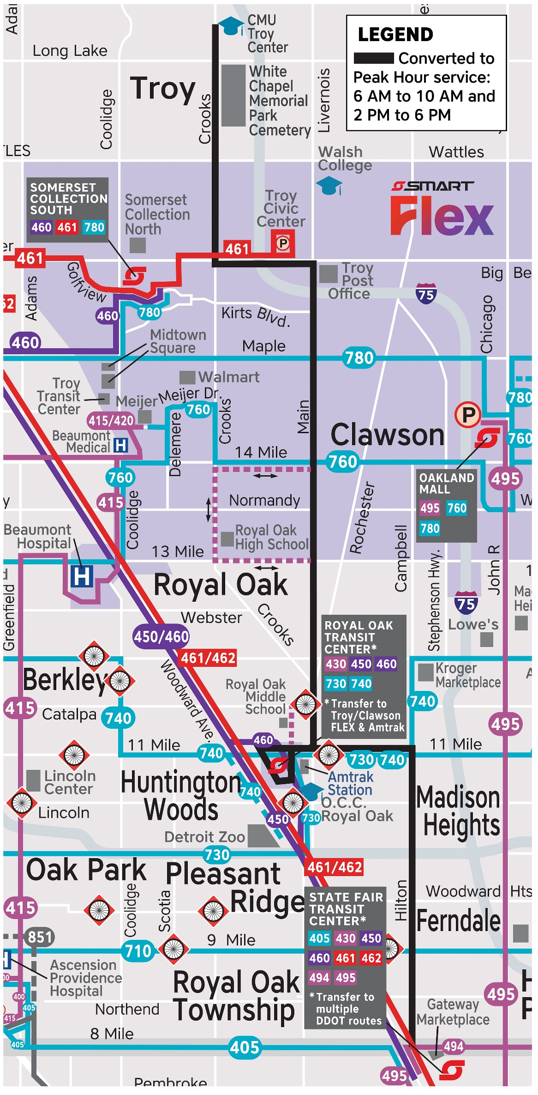
430 Main Street
Convert to Peak Hour Trips Only
New hours: 60 minute frequency, weekdays 6 a.m. to 10 a.m., and 2 p.m. to 6 p.m.
Service maintained during periods with strongest ridership
Trips to Royal Oak Middle and High Schools will continue
Service throughout Troy, Clawson, and to the Royal Oak Transit Center will be available seven days a week using SMART Flex Troy, and Monday-Saturday on Route 492 Rochester

Slide 12
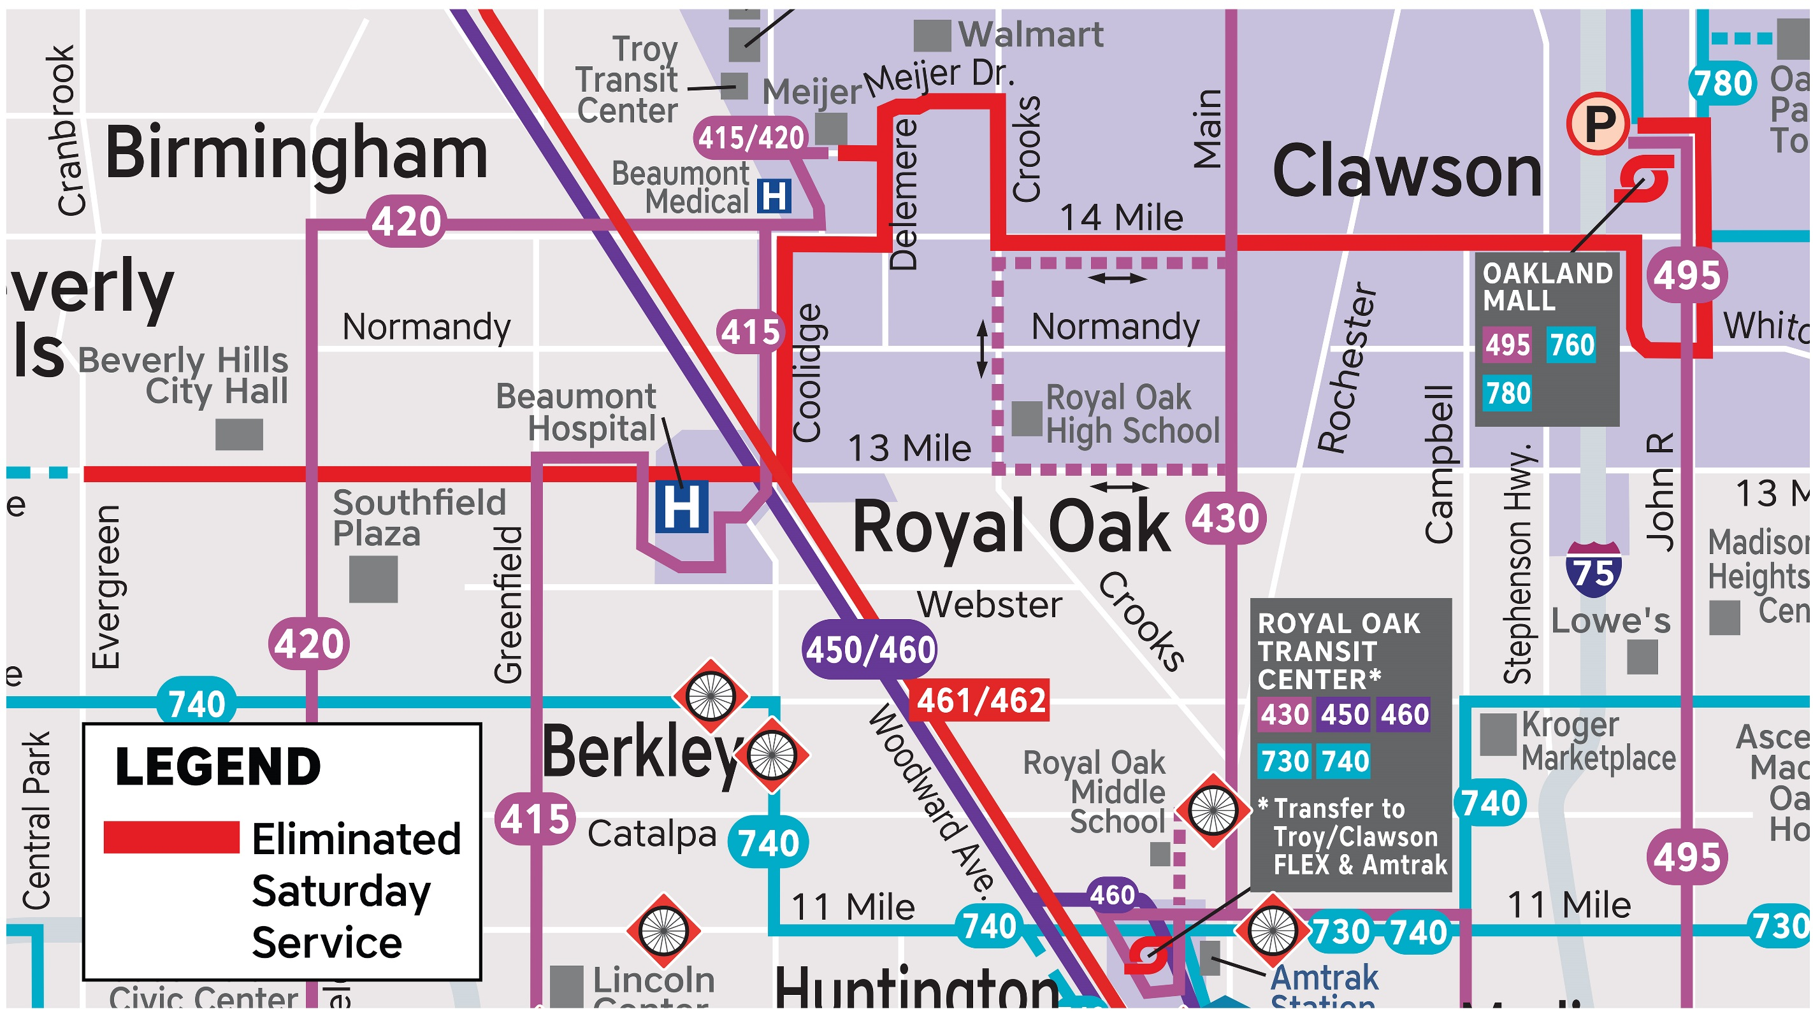
760 Thirteen Mile/Fourteen Mile
– DISCONTINUED ROUTE –
Saturdays ONLY
Weekday service will
remain uninterrupted
Discontinued on Saturdays, due to ongoing low ridership
SMART Flex provides rides throughout Troy and Clawson, and covers the route from William Beaumont to Oakland Mall and beyond
Fixed route alternatives include:
415 Greenfield (to William Beaumont, Coolidge, and Royal Oak Meijer)
420 Southfield (to Beverly Hills)
780 15 Mile (to Oakland Mall)

Slide 13
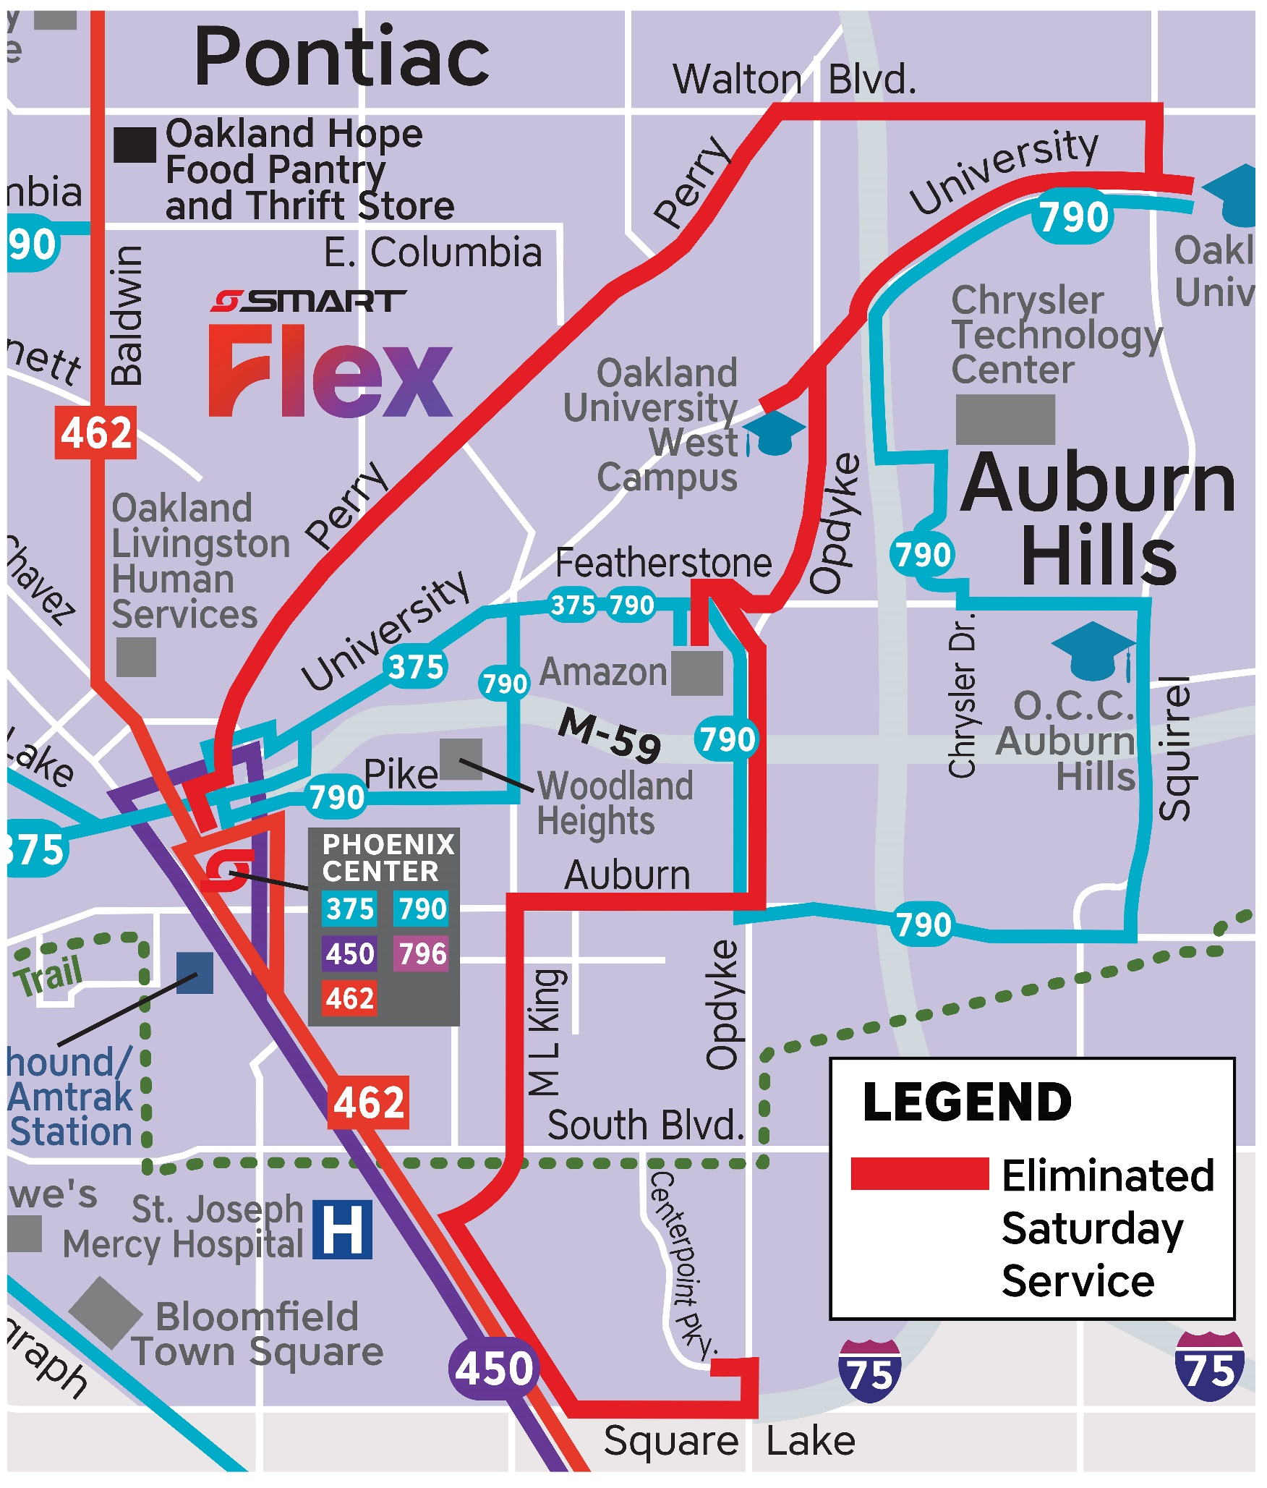
796 Perry/Opdyke
– DISCONTINUED ROUTE –
Saturday ONLY
Discontinued on Saturdays due to ongoing low ridership
Service between OU-Main and OU-West will be provided along University by the reconfigured 790 Pontiac Crosstown
Service on Perry and Walton will be available on the 759 Highland
Opdyke, Auburn, MLK, Square Lake, and Centerpoint Parkway will be accessible from anywhere in Pontiac or Auburn Hills via the SMART Flex Pontiac

Slide 14
Thank you for riding SMART!
SMART continues to evolve with the needs of Metro Detroit
These service changes are the “phase one” of new, improving service in Oakland County
As transit is introduced and expanded in the coming months and years, SMART will collaborate with the people and leadership of Oakland to meet everyone’s mobility needs
SMART is on its way to the top as a mobility provider, and we look forward to bringing our passengers along for the ride!
Stay tuned for future opportunities, and remember:
SMART MOVES US!

